Slide 1
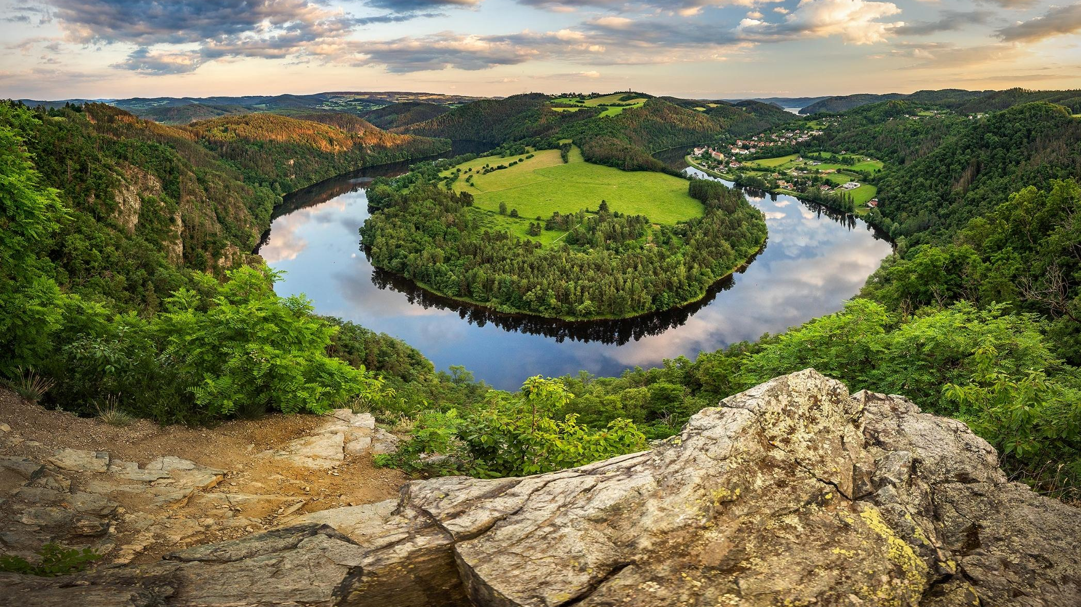
River basin

Slide 2
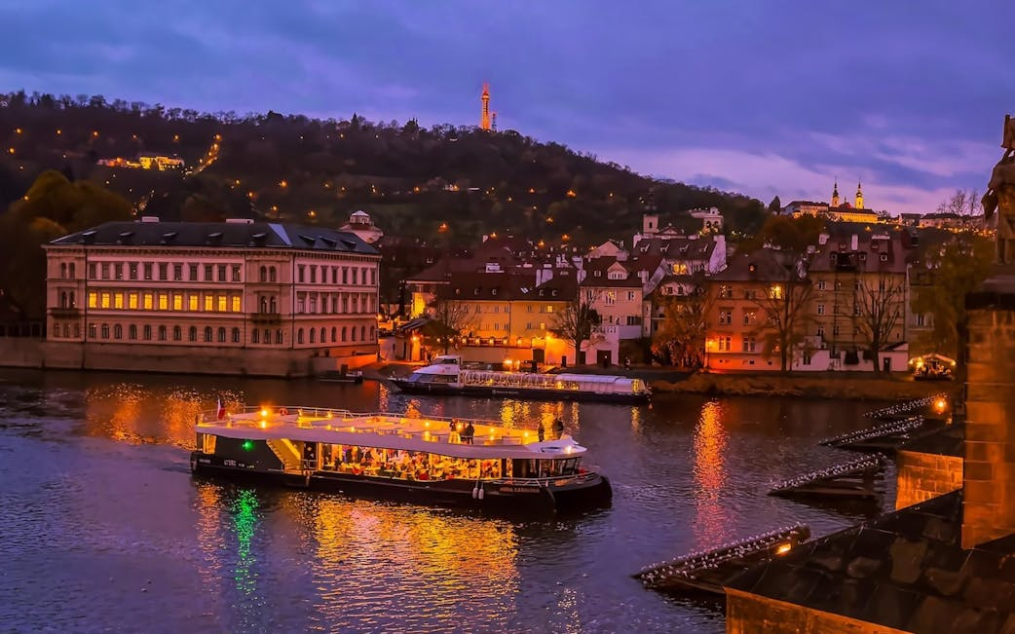
Vltava
River in the capital city
The longest river in the Czech Republic
National river
Cultural importance
  Symphonic poem Vltava
  Paintings
  Poems

Slide 3
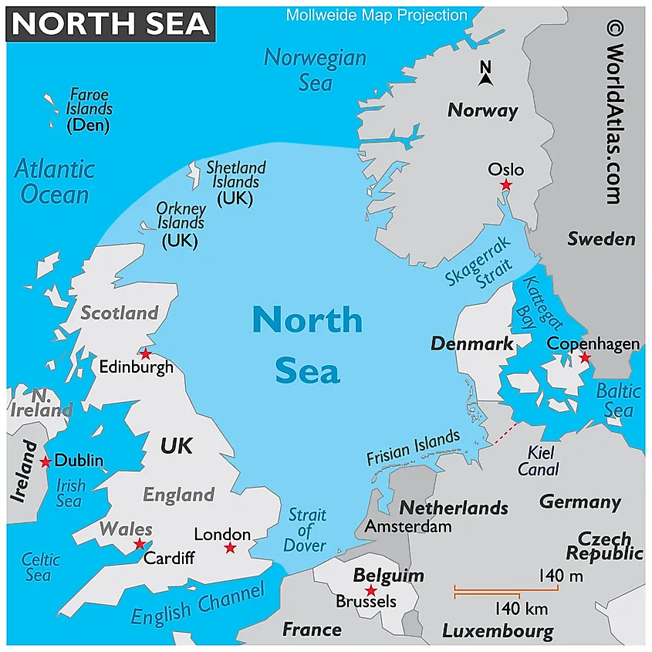
Drainage basin
North Sea
  Labe
Black Sea
  Morava, Vltava
Baltic Sea
  Odra

Slide 4
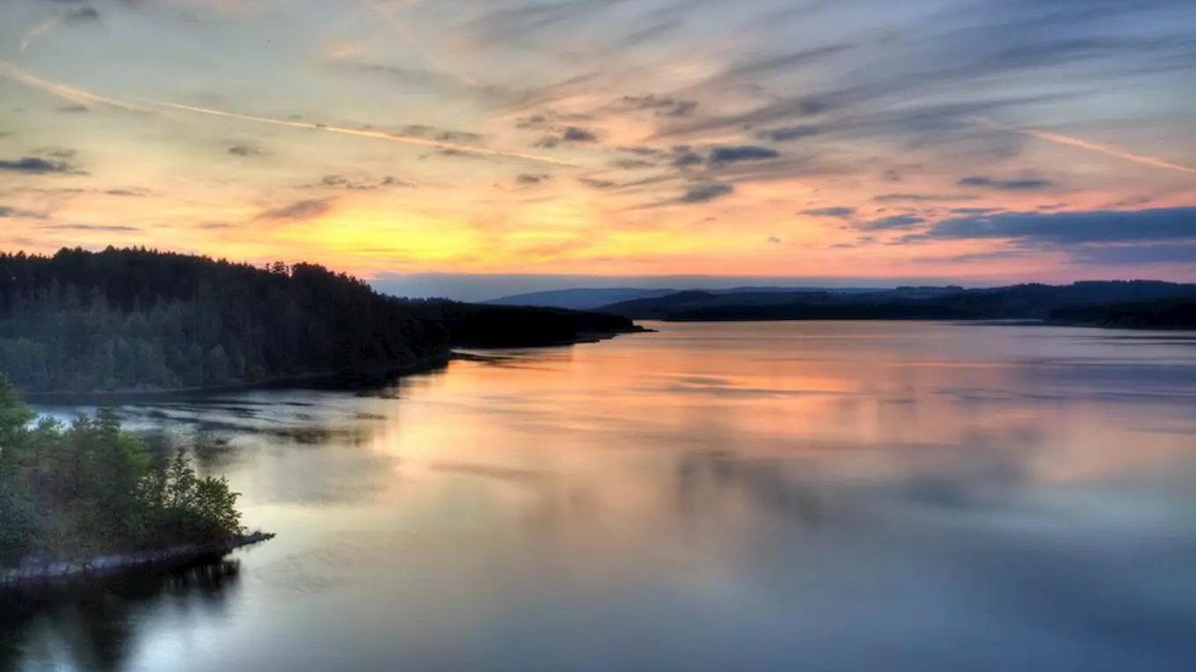
Ponds
More than 24 000 ponds in the Czech Republic
Since 11th century
Fish farming
  Carp
  Pike
Water goblins - Vodník

Slide 5
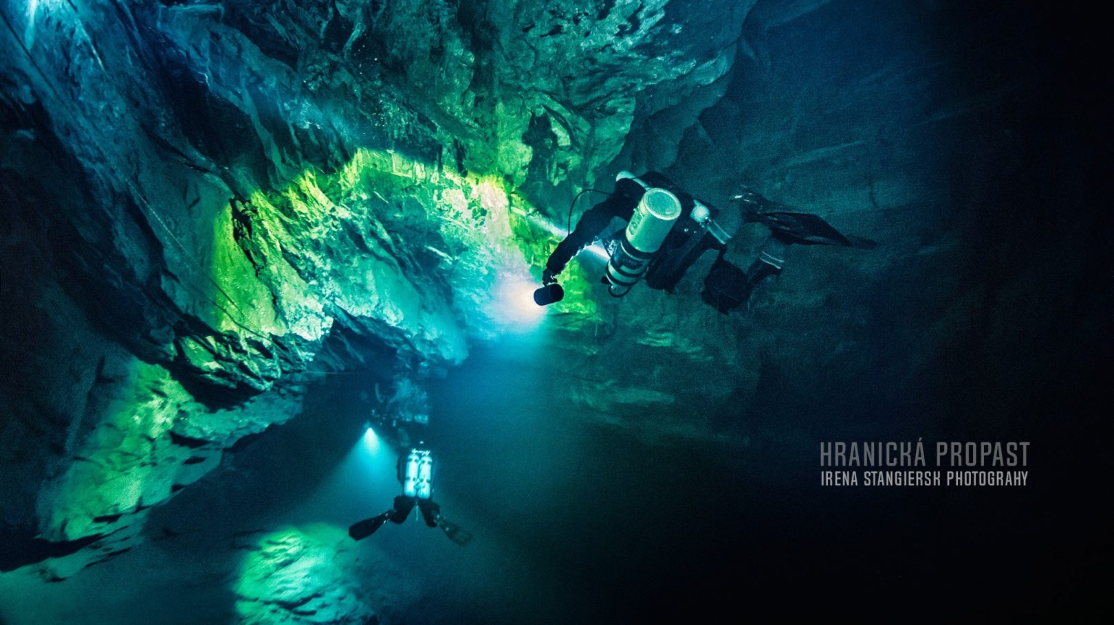
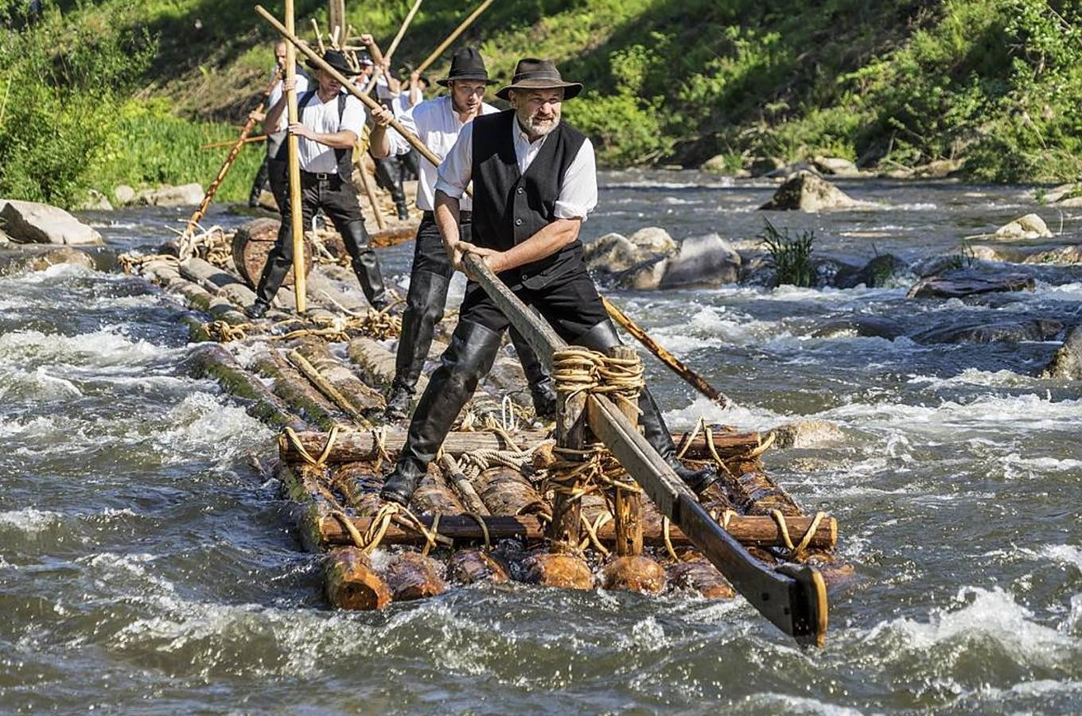
Facts
Timber rafting – UNESCO
Highest daily rainfall
Deepest freshwater underwater cave
Winter swimmers

Slide 6
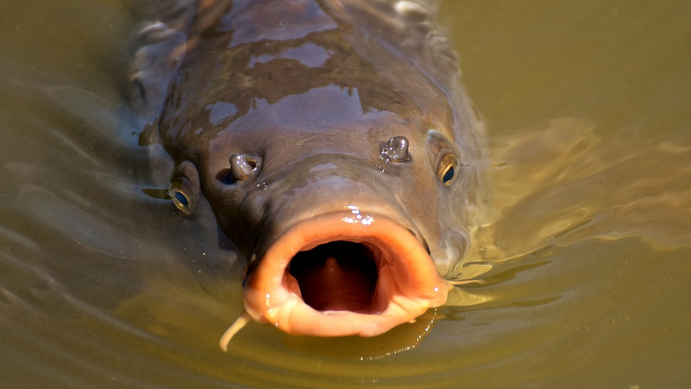
THANK YOU FOR YOUR ATTENtION

